Slide 1




STARTUP SURVIVAL:
A HUMAN CAPITAL PERSPECTIVE
By Arpa Banik
Authors: Josef Brüderl, Peter Preisendörfer, Rolf Ziegler
Notes:
Good afternoon, everyone, thank you for joining me today. I'm presenting a replication of Brüderl et al.’s 1992 study titled 'Survival Chances of Newly Founded Business Organizations.' This work examines what helps new startups succeed—or fail—using a theoretical blend of human capital and organizational ecology. I used the same dataset and statistical model to reproduce their findings and will walk you through the key steps and results.

Slide 2



Introduction
Significant rise in business formation across Europe in the 1980s
Hopes attached to new ventures: job creation, innovation, competitiveness​
BUT: Many new firms fail quickly​
Research question: What determines whether new businesses survive?​
Notes:
During the 1980s, there was a major wave of entrepreneurship in both Western and Eastern Europe. People believed new businesses would create jobs, drive innovation, and boost competitiveness. But the reality was that many of these ventures failed quickly. This paper addresses a crucial question—what factors actually influence a new business’s chance of survival? The study aims to answer that by analyzing nearly 1,850 firms launched in Munich and Upper Bavaria.

Slide 3



Theoretical Framework
Combines two theories to explain survival:​
Human Capital Theory: Attributes of the founder impact productivity and access to resources​
Organizational Ecology: Emphasizes age, size, strategy, and environmental fit of the organization​
Research gap: Past studies lacked theoretical grounding and used weak data​
​
​
Notes:
The study builds on two main theories. First, Human Capital Theory—this focuses on the founder’s personal characteristics like education and experience. Second, Organizational Ecology, which looks at organizational traits and external environment. Importantly, the authors highlight that previous studies were either too small in sample size or lacked theoretical depth. By combining these lenses, the authors offer a more holistic view of startup survival and generate testable hypotheses across individual, organizational, and environmental dimensions.

Slide 4
Human Capital Theory
General Human Capital:
More years of schooling = higher survival chances (improves decision-making, access to resources)
More work experience = greater knowledge and skill application
Specific Human Capital:
Industry-specific experience: Helps navigate market, avoid pitfalls
Prior self-employment: Mixed results—may help or reflect failed past attempts
Leadership experience: Important when managing employees
Self-employed father: Early exposure to entrepreneurship, serves as a role model
​
Notes:
Human capital is broken into two types. General human capital—like years of schooling and work experience that boosts survival by improving productivity.
Specific human capital is more nuanced. Industry-specific experience helps navigate familiar terrain. Leadership and self-employment experience may help in managing others and making strategic decisions. Even having a self-employed parent can offer early exposure to entrepreneurial skills.

Slide 5
Organizational Ecology
Liability of Newness: Young firms lack routines, legitimacy
Liability of Smallness: Limited resources = higher vulnerability
Strategy types:
Generalists (broad markets) vs Specialists (focused niches)
Innovators (new products) vs Imitators (existing markets)
Local vs National market reach
Environmental Factors: Urban vs rural, competitive intensity, industry type
​
Notes:
From an ecology perspective, young and small businesses are vulnerable. The ‘liability of newness’ means they haven’t yet developed stable routines. The 'liability of smallness' reflects how limited resources increase failure risk. Strategy also plays a role—broad vs niche focus, innovation vs imitation, local vs national reach. The environmental factors, such as industry type or location, further shapes outcomes.

Slide 6
Data and Methodology
Data: Munich Founder Study
Sample of 1,849 business founders from 1985-86
Stratified by survival status in 1990
Method:
Event history (survival) analysis
Dependent variable: months until closure or right censoring (still operating)
Main model: Proportional Log-Logistic Hazard Model
Notes:
The authors used data from the Munich Founder Study, which surveyed 1,849 founders of firms started between 1985 and 1986. The main outcome was how long the business survived. They applied a log-logistic survival model—well-suited for modeling the 'liability of adolescence' where risk is highest shortly after founding and then declines. Right-censored cases—still-active firms in 1990—were handled accordingly.

Slide 7



Key Variables Analyzed
Human Capital:
Years of schooling, work experience (linear and squared), industry experience, prior self-employment experience, leadership experience, parental self-employment.
Organizational Features:
Initial capital (log), number of employees (log), legal registration
Business strategy (specialist/generalist, innovator/traditional, market scope)
Environmental Features:
Location (Munich vs Upper Bavaria), industry type, competition, seasonality, clustering of orders
Notes:
Here’s a snapshot of the variables they tested. For human capital: education, work experience, and background traits. For organizational factors: how much capital was invested, number of employees, whether it was a legally registered firm, and strategic focus. Environmental variables include whether the business was located in Munich or elsewhere, industry type, and conditions like seasonality or market competition.”

Slide 8
Data Challenges and Cleaning
Raw data and codebook were in German
300+ variables; ambiguous labels
Required translation, recoding, and merging multiple files
Used Python to:
Convert employment and capital to log scale
Recode categorical text (e.g., “small tradesman”, “follower”)
Create binary indicators
Notes:
One of the biggest challenges in replicating this study was working with the original dataset and codebook, both of which were in German. With over 300 variables, identifying the right ones was like solving a puzzle. I had to translate, interpret, and match variables to those used in the original paper, often relying on context and theory.
Data cleaning involved recoding text variables, handling missing values, and transforming numerical fields. For example, I recoded “Business still registered” as a censored observation and converted variables like capital and employees to a log scale. I also created binary flags for business types — like whether the firm was a follower or targeted a national market — all using Python.
This process was essential to align my dataset with the structure and assumptions of the original model. Without this level of cleaning, I wouldn’t have been able to replicate the survival analysis properly.

Slide 9
Model Specification
Method: Parametric Log-Logistic AFT Model
Censoring: 1 if still alive in 1990
Replicated the “liability of adolescence” concept — mortality peaks around 9–12 months
Notes:
For the survival analysis, I used R and fitted a parametric log-logistic AFT model, just like Brüderl et al. did. This model is great for capturing non-linear hazard rates — in this case, the "liability of adolescence," where failure risk peaks around 9 to 12 months after founding.
I treated firms still alive in 1990 as right-censored, so they were included without assuming failure. The model helped show how certain founder and organizational traits slow down or speed up business failure.
I used a log-logistic accelerated failure time (AFT) model, the same as Brüderl et al. This is a parametric survival model, which assumes a specific distribution for the time-to-event — in our case, how long businesses survive before failure.
Unlike the Cox proportional hazards model, which is semi-parametric, AFT models directly estimate how covariates accelerate or decelerate the time to failure. In other words, instead of looking at the relative hazard, we model the log of survival time as a linear function of the covariates.
Mathematically, the AFT model is structured as:
where TiT_iTi is the survival time for firm iii, and ϵi\epsilon_iϵi follows a log-logistic distribution. This distribution is flexible and can model both monotonic and non-monotonic (inverted-U) hazard rates, which is critical here.
One unique feature of the log-logistic model is its hazard function:
When p > 1, the hazard function increases to a peak and then declines — matching the “liability of adolescence” described in the paper.
This is exactly what we see — the failure rate increases initially, peaking between 9–12 months after business founding, then declining.
I verified this pattern using the estimated shape parameter from the model, which was significantly greater than 1, confirming that the hazard follows an inverted U-shape.
I also applied right-censoring: businesses still alive at the end of the observation window (1990) weren’t assumed to have failed — instead, their data was included as censored, which preserves unbiased estimation of the hazard and survival functions.
Covariates like capital invested and number of employees were log-transformed to normalize skewness and ensure linearity in the log-time scale.
Finally, the model was fitted using maximum likelihood estimation, which is standard for AFT models, and all variables were checked for multicollinearity and missingness before inclusion.
So, overall, the replication model was statistically sound, matched the theoretical assumptions in the original study, and successfully confirmed the core findings using modern tools in R.

Slide 10
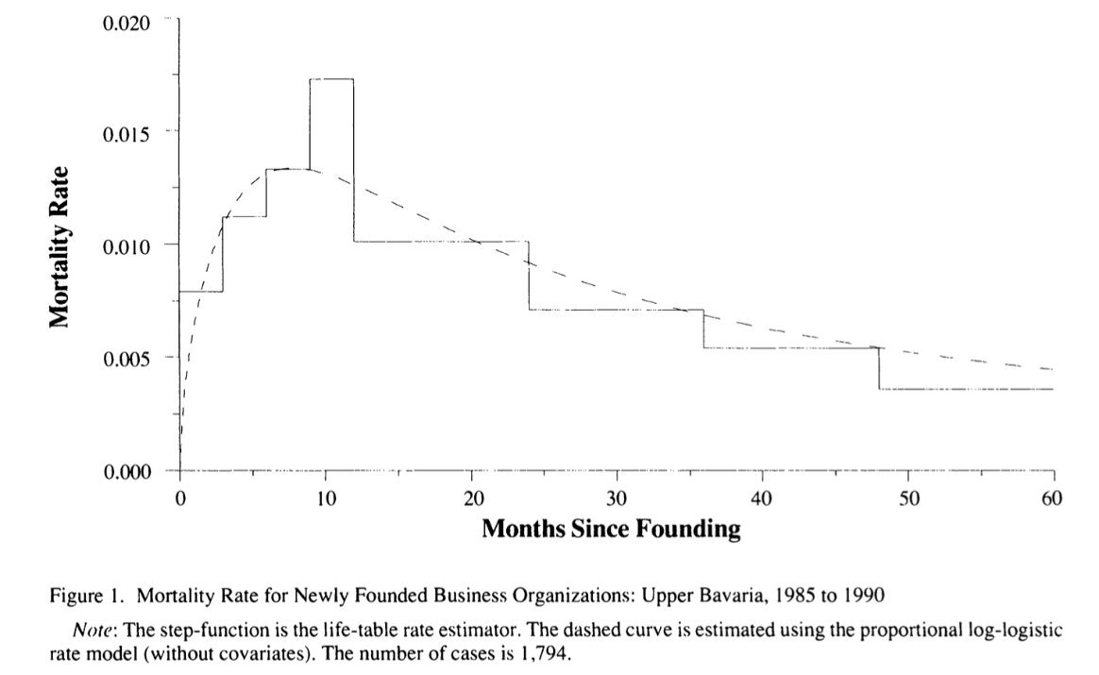
Mortality rate over time shows a peak around 9–12 months after founding
This reflects a “liability of adolescence” — firms often survive early months on initial resources, but risk peaks shortly after
Inverted U-shaped mortality — firms are most at risk around 9–12 months
The curve declines afterward, showing survival improves for businesses that last past the critical first year
Dashed line: fitted hazard model; Step function: life-table estimate from raw data
Notes:
Here we see the hazard rate of business failure. The step function reflects empirical data, while the dashed line is the fitted log-logistic model. Notice that the risk of failure peaks around 9–12 months after founding—this supports the idea of a 'liability of adolescence.' If a firm survives that critical window, its chances of long-term survival increase significantly.

Slide 11




Key Statistical Results
Human Capital:
Years of schooling: coefficient = -0.054, t = 3.18 (significant)
Work experience: positive effect; diminishing returns (squared term significant)
Industry-specific experience: coefficient = -0.332, t = 3.53 (highly significant)
Other factors (self-employment, leadership, parental background) had weaker or insignificant effects in multivariate model
Organizational Characteristics:
Follower businesses: coefficient = -0.446, t = 3.46 (significantly lower failure risk)
Affiliated businesses: coefficient = +0.278, t = 2.06 (higher failure risk)
Capital invested (log): coefficient = -0.034, t = 3.40
Number of employees (log): coefficient = -0.451, t = 5.01
Registered firms: coefficient = -0.793, t = 4.48 (strongest effect in size variables)
Strategy Effects:​
National market: coefficient = -0.363, t = 3.59 (significant)​
Specialist and innovative strategies: weak or borderline significance​
​
Environment Effects:​
Location in Munich: not statistically significant​
Industries with high clustering of orders had better survival (coefficient = -0.519, t = 3.90)​
Notes:
These are the key findings. Human capital variables like education and industry experience significantly lowered failure rates. Work experience had diminishing returns. Among organizational features, having more capital, employees, or being registered all improved survival. Follower businesses did better, but surprisingly, affiliated businesses did worse—possibly due to weak franchise agreements. Businesses targeting national markets survived longer. Environmental factors were less influential overall, though businesses in industries with clustered orders did better.

Slide 12



Key Findings
Human capital (education, experience) reduces failure
Capital investment and number of employees boost survival
Registered firms do better than small tradesman
Follower businesses outperform newcomers
National market focus improves outcomes
Retail and transportation sectors face higher failure
Founders with more human capital start stronger firms
Human capital affects both directly and through better firm setups
Notes:
This slide sums up the key results from both bivariate and multivariate models. Founders with more education and experience — especially in the same industry — had better survival odds. Larger firms, with more capital, employees, and formal registration, also did better.
Follower firms and those targeting a national market were more resilient, while retail and transport businesses showed higher failure.
Lastly, we saw strong selection effects — better-educated founders tended to start better-equipped firms, which further improved their survival chances. So, human capital mattered both directly and indirectly.
Starting with human capital, founders with more years of education and prior work experience — especially in the same industry — showed significantly lower failure rates. This supports the idea that better-prepared individuals are more likely to lead successful businesses.
Next, organizational size mattered a lot. Firms that started with more capital, more employees, and a formal legal registration were more likely to survive. The data showed that these resources help businesses weather early challenges and scale effectively.
We also saw that follower firms — those that continue an existing business — outperformed de novo startups. And firms targeting a national market fared better than those focusing only locally, possibly due to broader customer reach or better business strategies.
On the flip side, retail and transport sectors had the highest failure rates, likely due to higher competition and lower barriers to entry.
Finally, and most interestingly, we observed selection effects: founders with high human capital were more likely to start better-endowed firms in the first place — those with more capital, employees, and strategic orientation. So, human capital influences both the quality of the business setup and its survival prospects, directly and indirectly.
These findings closely mirrored the original paper, reinforcing the strong role of both individual and organizational characteristics in early business survival.

Slide 13

Practical Recommendations
For Founders:
Avoid starting "too small"—size matters for survival
Gather industry experience before launching a venture
Consider targeting broader markets (national reach)
Policy Relevance:​
Training programs should focus on industry-specific skills​
Capital access for better-funded startups can lower mortality​
Notes:
For founders: aim to start at a viable scale, get industry experience before launching, and consider reaching beyond local markets. For policymakers: support training programs that develop industry-specific skills and make capital more accessible to qualified startups. These steps could reduce early-stage failure rates.

Slide 14
Conclusion and Future Directions
Conclusion:
Strong support for integrating human capital and organizational ecology frameworks
Organizational characteristics (especially size and market strategy) are the most powerful predictors
Industry experience is the strongest individual factor among founders
Future Research:​
Role of social capital: networks, mentorship, peer support​
Explore other success metrics: growth, profitability, sustainability
Examine interaction effects (e.g., how market conditions moderate the effect of strategy)​
Notes:
In conclusion, this study validates the joint power of human capital and organizational structure in explaining startup survival. Industry experience stood out as the strongest individual factor, while capital and size were the most influential firm characteristics. For future research, we could look at the role of networks and social capital or explore success metrics beyond survival—like profitability or job creation."

Slide 15


TAKEAWAYS
Notes:
This replication wasn’t just a data science exercise — it was a lesson in the real-world complexity of working with sociological survey data, especially when it’s old, multilingual, and massive in scope.
First, the data wrangling was intense. The dataset and the codebook were written entirely in German, and even with translation tools, understanding the nuanced meanings of variable labels or survey responses required cross-checking across documentation, context, and common sense. It felt less like coding and more like detective work at times. With 300+ variables, it was easy to lose track unless I worked methodically and documented every step.
Second, mapping those variables to theory was absolutely critical. The paper refers to constructs like "general human capital" or "organizational newness" — but these aren’t single columns in the dataset. They had to be constructed carefully. For instance, “industry-specific experience” was derived from a binary interpretation of a text response, and “registered firm” required recoding based on legal form descriptions. It made me realize how essential it is to ground your variables in theoretical clarity.
One big takeaway was how much human capital and firm structure still matter. Even though this study was based in 1980s Germany, the predictors of survival — like education, experience, capital, and size — remain highly relevant. It reinforced my belief that solid sociological theories often stand the test of time.
Lastly, replicating the model taught me the value of rigorous alignment. Slight differences in how you clean, transform, or define a variable — like logging capital invested or deciding how to handle missing data — can significantly shift the results. It gave me a deeper appreciation for the transparency and reproducibility that good research demands. It also reminded me why so few replications exist — they’re hard, but incredibly rewarding.

Slide 16
THANK YOU
Notes:
That wraps up my presentation. Thanks so much for your attention—I’m happy to take any questions .

